Slide 1
Component 3:
Combinational Logic Synthesis
Implementation Technology and Logic Design
  Design Procedure
    The major design steps: specification, formulation, optimization, technology mapping, and verification
  Technology Mapping
    From AND, OR, and NOT to other gate types
  Verification
    Does the designed circuit meet the specifications?
Chapter 3 - Part 1 <number>

Slide 2
Combinational Circuits
A combinational logic circuit has:
  A set of m Boolean inputs,
  A set of n Boolean outputs, and
  n switching functions, each mapping the 2^{m} input combinations to an output such that the current output depends only on the current input values
A block diagram:
Combinatorial
Logic
Circuit
m Boolean Inputs
n Boolean Outputs
Chapter 3 - Part 1 <number>

Slide 3
Design Procedure
Specification
  Write a specification for the circuit if one is not already available
Formulation
  Derive a truth table or initial Boolean equations that define the required relationships between the inputs and outputs, if not in the specification
Optimization
  Apply 2-level and multiple-level optimization
  Draw a logic diagram or provide a netlist for the resulting circuit using ANDs, ORs, and inverters
Chapter 3 - Part 1 <number>

Slide 4
Design Procedure
Technology Mapping
  Map the logic diagram or netlist to the implementation technology selected
Verification
  Verify the correctness of the final design
Chapter 3 - Part 1 <number>

Slide 5
Design Example 1
Design a voting system using digital logic based on majority rule, take 3 voters as example.
Chapter 3 - Part 1 <number>

Slide 6
Truth Table
Write down the logic function expression
K-Map to simplify the circuit
Draw the logic diagram
Convert to NOT implementation

Slide 7
Truth Table
A B C
L
0 0 0
0 0 1
0 1 0
0 1 1
1 0 0
1 0 1
1 1 0
1 1 1
0
0
0
1
0
1
1
1

Slide 8
Logic Function Expression
Y = m₄ + m₆ + m₇ + m₈
Chapter 3 - Part 1 <number>

Slide 9
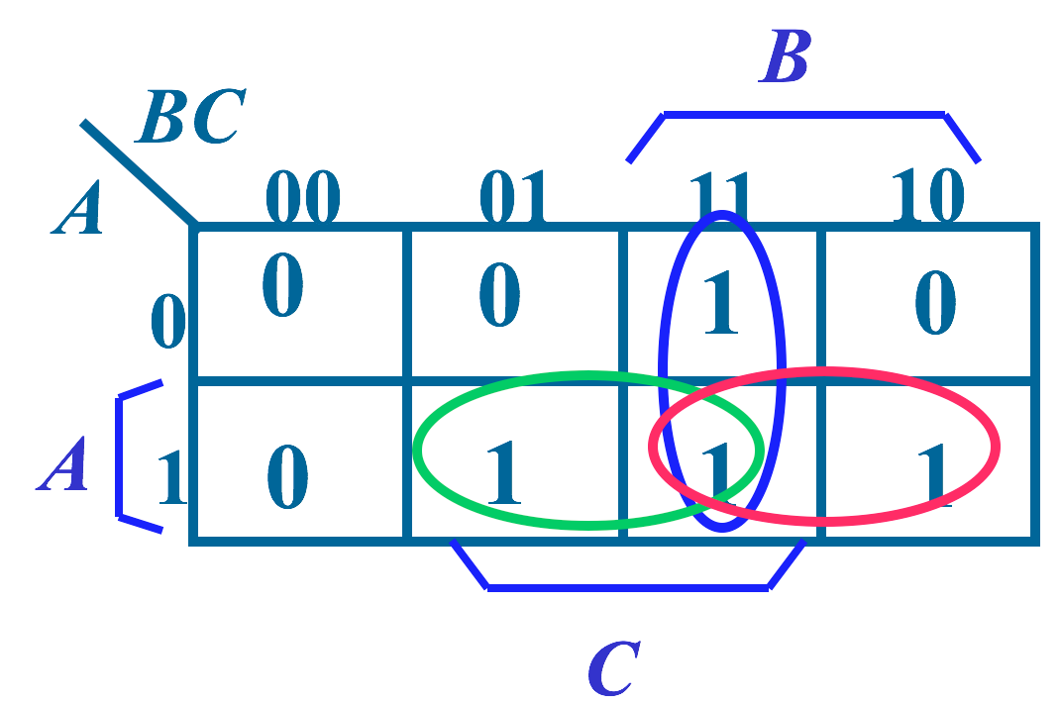
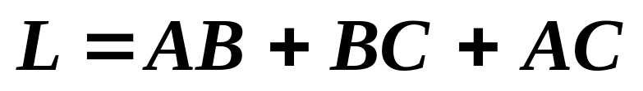
Simplification
Chapter 3 - Part 1 <number>

Slide 10
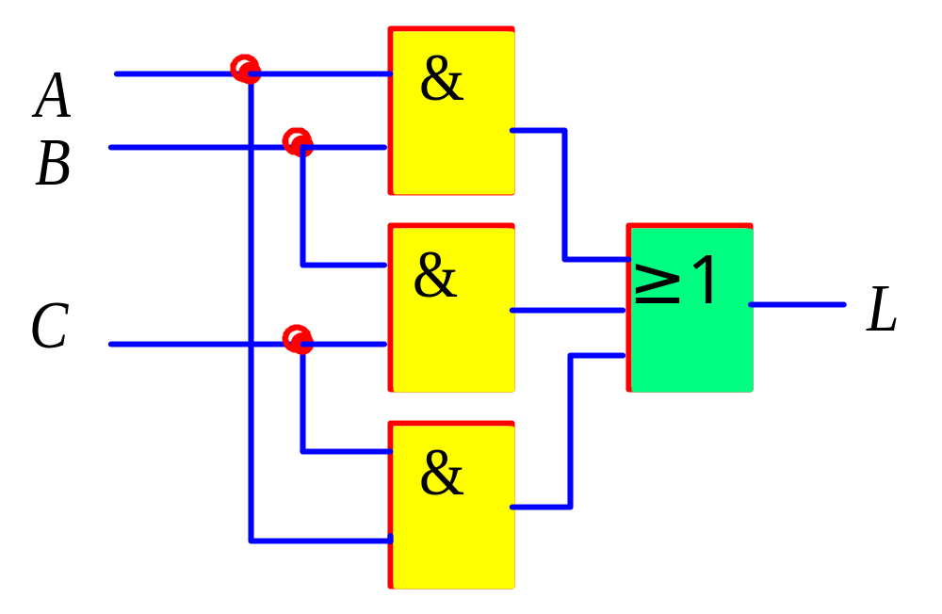
Logic Diagram
Chapter 3 - Part 1 <number>

Slide 11
Design Example 2
In a game, there are one chief judge and two assistant judge. To decide a foul, the chief judge and at least one assistant judge have to say “Yes”. Please design the logic circuit
Chapter 3 - Part 1 <number>

Slide 12
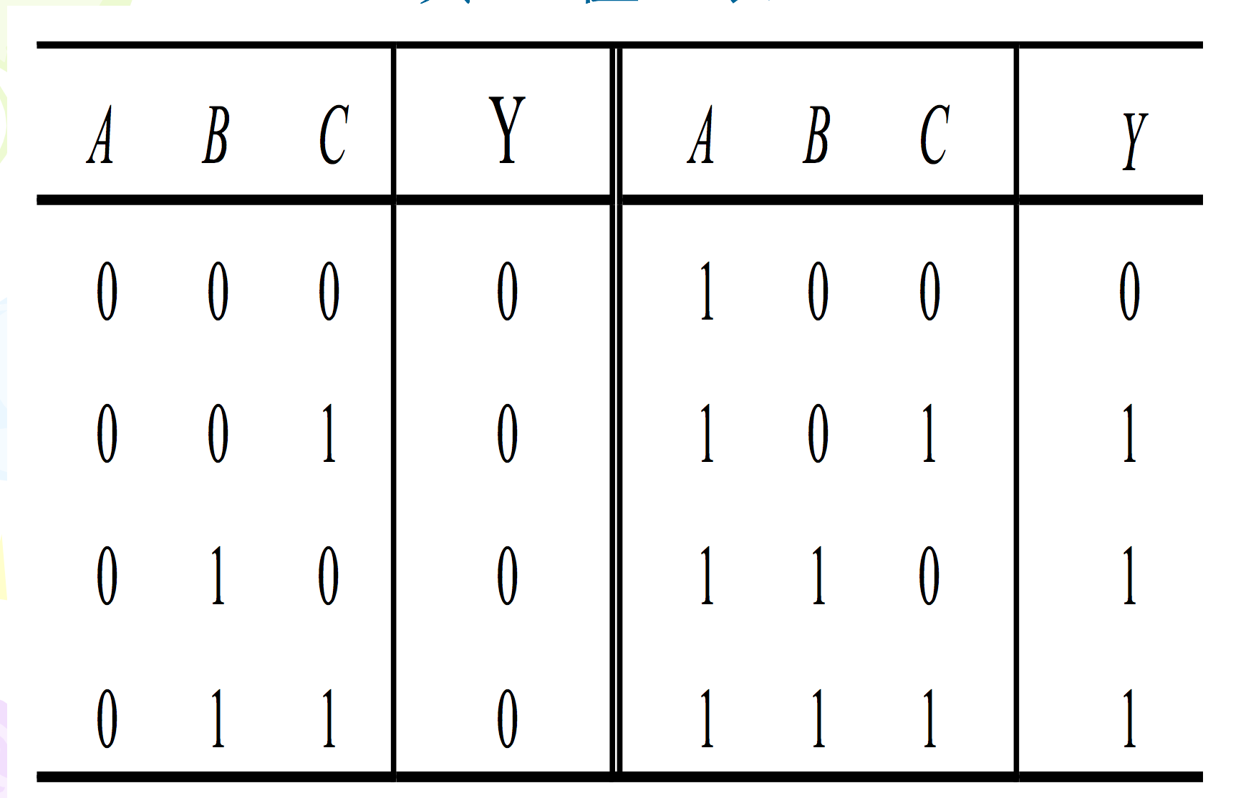
Truth table
Chapter 3 - Part 1 <number>

Slide 13
Logic expression
Chapter 3 - Part 1 <number>

Slide 14
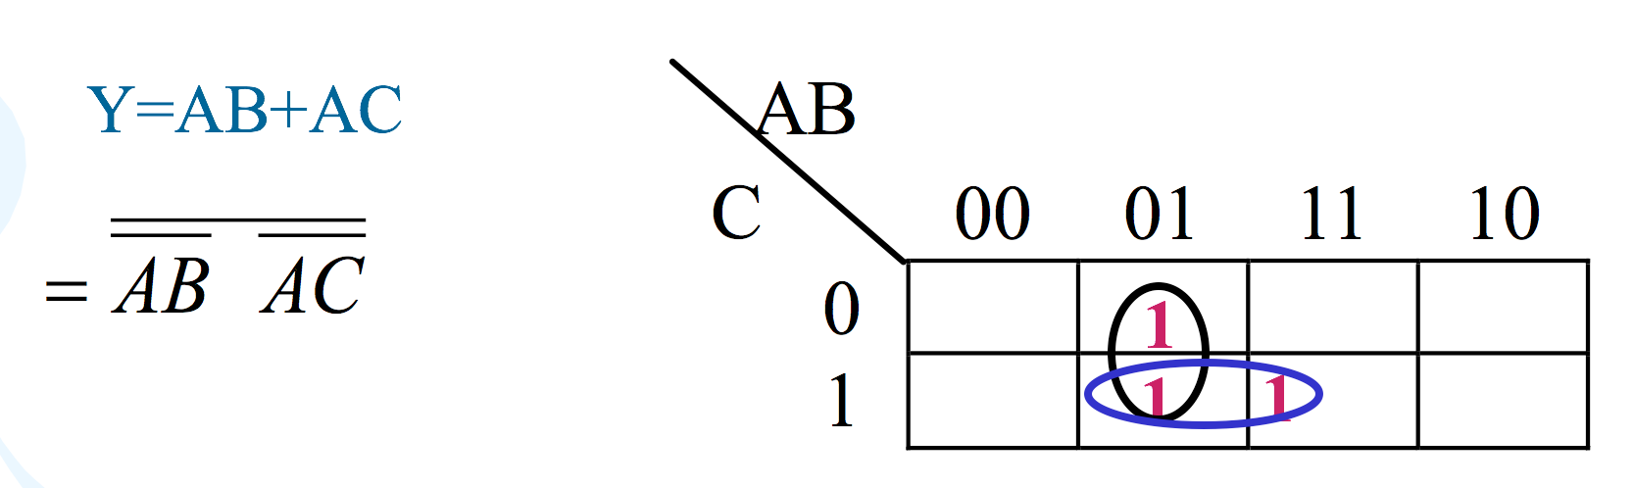
Simplification
Chapter 3 - Part 1 <number>

Slide 15
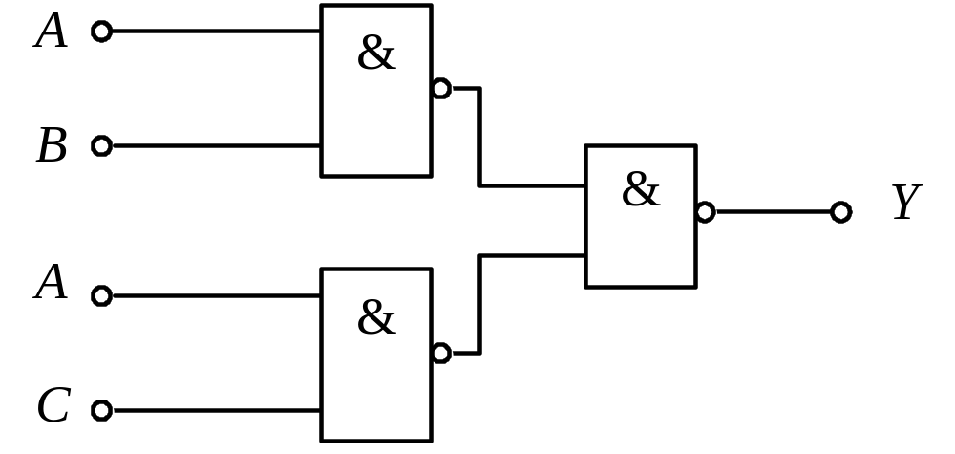
Logic diagram
Chapter 3 - Part 1 <number>

